Slide 1
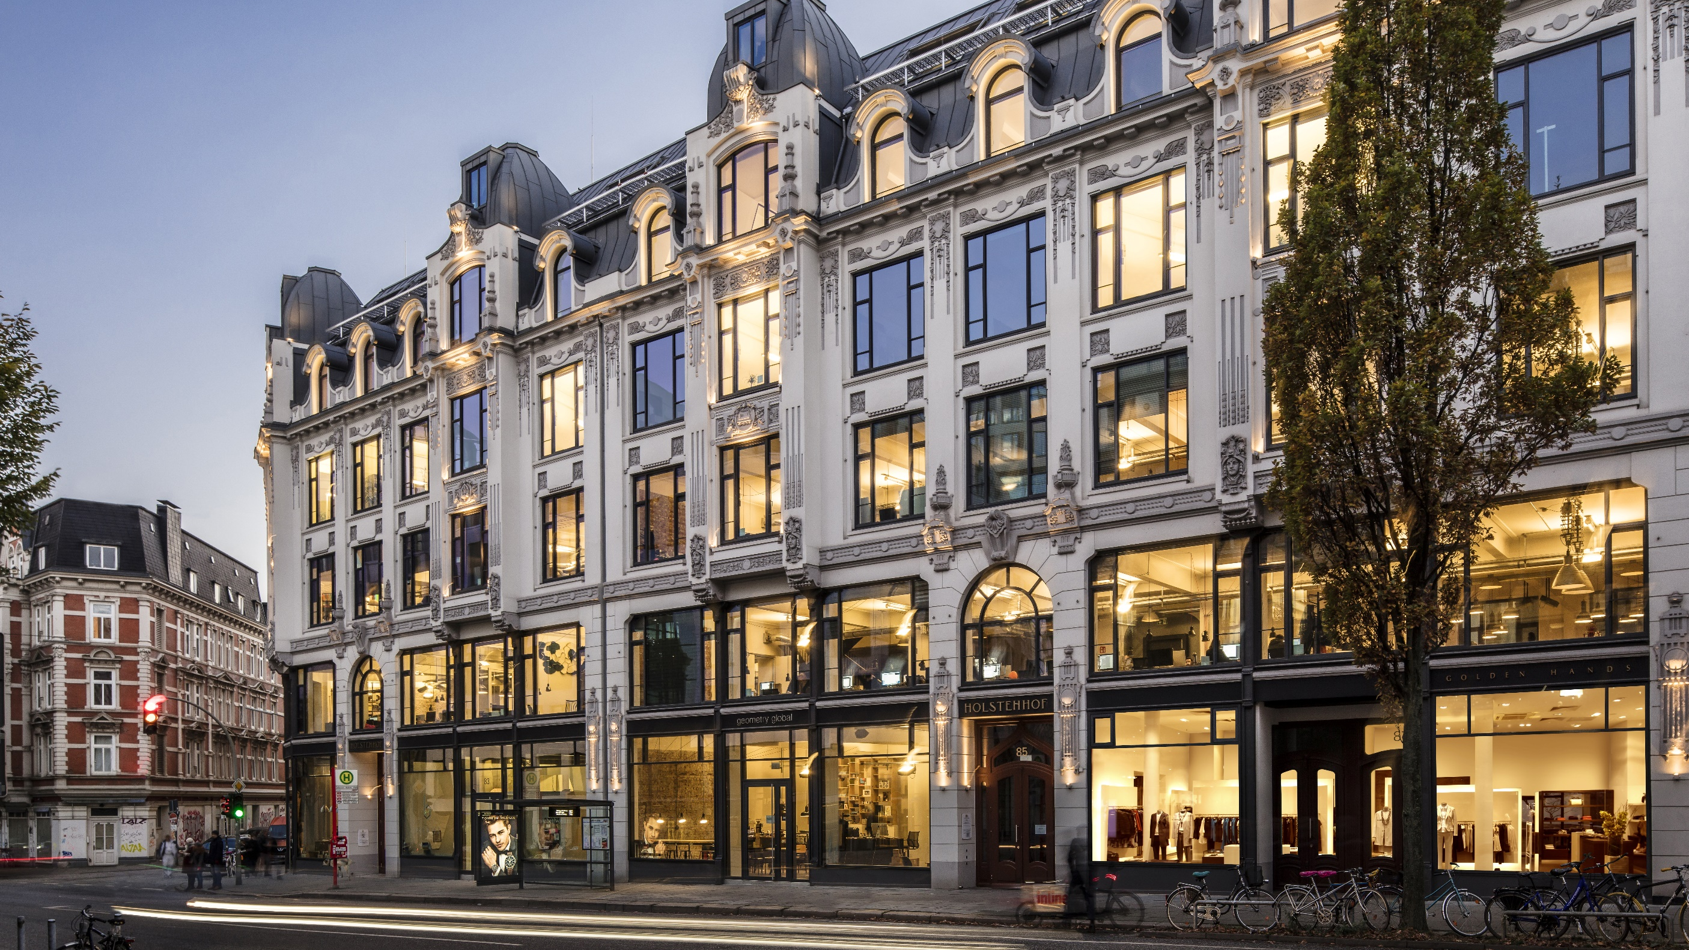
Additional Information 9M 2023
November 7, 2023

Slide 2
Disclaimer
Cautionary note regarding forward-looking statements
The statements contained herein may include statements of future expectations and other forward-looking statements that are based on management’s current views and assumptions and involve known and unknown risks and uncertainties that could cause ­actual results, performance or events to differ ­materially from those expressed or implied in such statements. Actual results, performance or events may differ materially from those in such statements due to, without limitation, general economic conditions, including in particular economic conditions in the alstria’s core business and core markets, general competitive factors, the impact of acquisitions, including related integration issues, and reorganization measures. Furthermore, the development of financial markets, interest rate levels, currency exchange rates, as well as national and international changes in laws and regulations, in particular regarding tax matters, can have a corresponding impact. Many of these factors may be more likely to occur, or more pronounced, as a result of terrorist activities and their consequences.
^{No duty to update}
The company assumes no obligation to update any information contained herein.

Slide 3
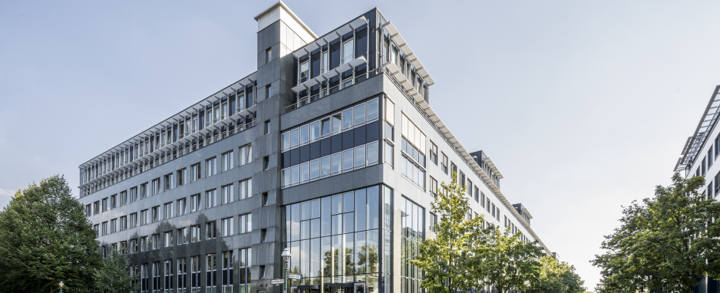
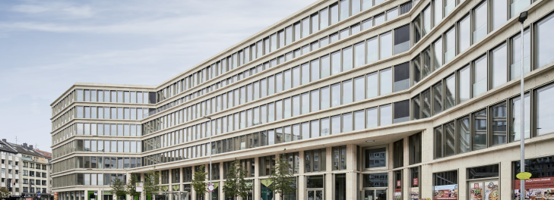
Portfolio by regions
Darwinstr. 14-18 , Berlin
AM wehrhahn 30, Düsseldorf

Slide 4
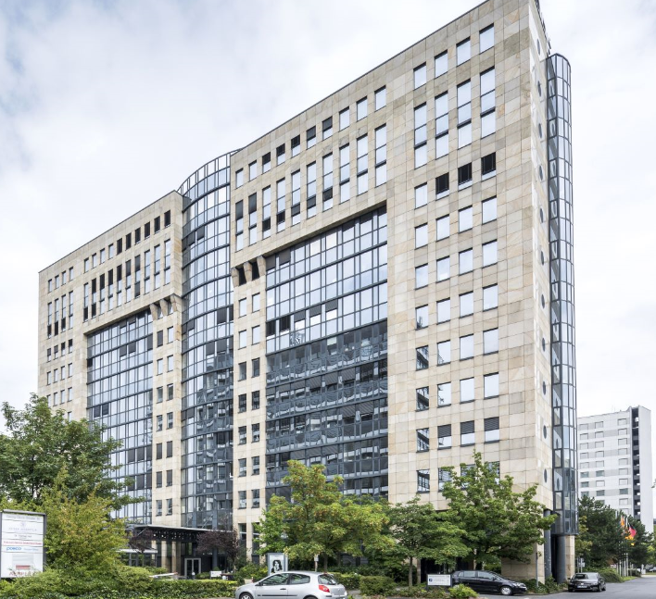
Vacancy
Georg-Glock-Str. 19, Düsseldorf

Slide 5
Office Leases

Slide 6
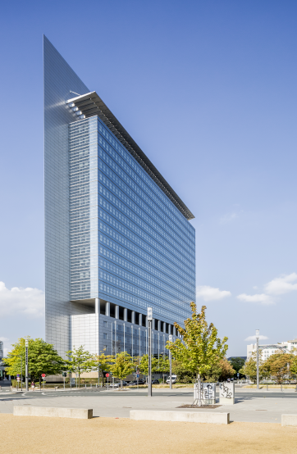
Refurbishment projects*
Platz der Einheit 1, Frankfurt
* Updated once a year as per year end, and therefore does not match the the data provided on prevoius slides (except Pre-let quota and lease signed: updated as per September 30, 2023)

Slide 7
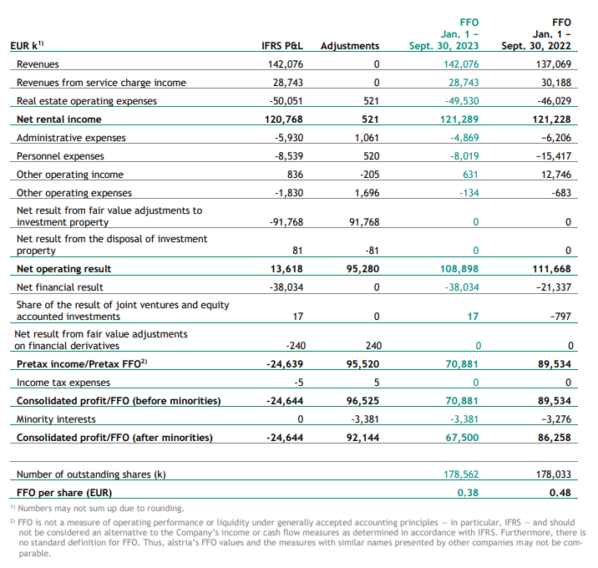
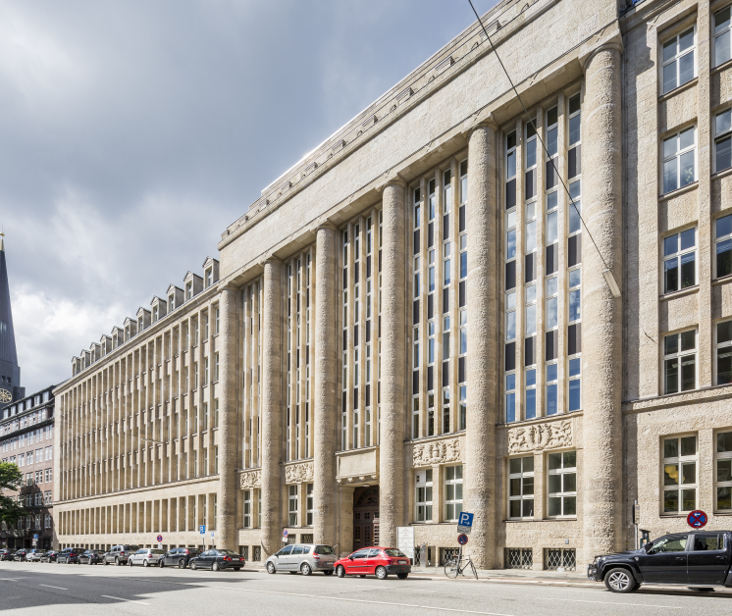
P&L and FFO
steinstr. 10, hamburg

Slide 8
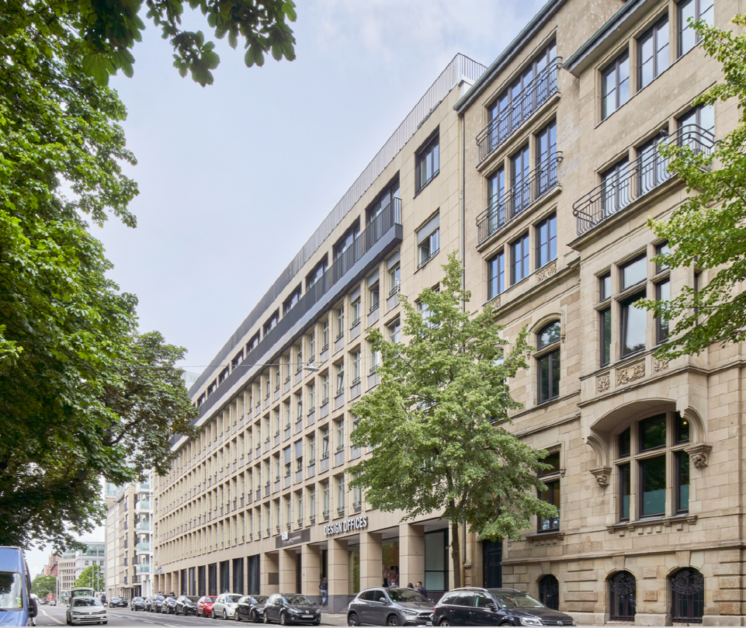
Balance sheet
 | Sep. 30, 2023 | Dec. 31, 2022
 | EUR M | EUR M
Investment properties | 4,625 | 4,607
Carrying amount of owner occupied properties | 16 | 16
Other assets | 3 | 3
Assets held for sale | 0 | 27
Carrying amount of immovable assets (B) | 4,644 | 4,652
Adjustments to fair value of owner occupied properties | 9 | 9
Fair value of immovable assets (C) | 4,654 | 4,662
Cash on balance sheet (D) | 301 | 365
IFRS equity (E) | 2,537 | 2,571
Interest bearing debt (F) | 2,372 | 2,403
G-REIT equity ratio (E/B) | 54.6% | 55.3%
Corporate LTV (F/B) | 51.1% | 51.7%
Corporate Net LTV (F-D)/B | 44.5% | 43.7%
elisabethstr. 5-11, Düsseldorf

